Slide 1
Dr. Wes Blog
http://drwes.blogspot.com
Every single claim made today / supporting documents / fully vetted here.
(Open comments)

Slide 2
The Maintenance of Certification MOC Story
1936
1986- Unilateral Decision to Implement Time-Limited Certification
1989 –WF Internal Medicine (#127308) “Grandfather”
1990 – All FUTURE Board Certification Time-limited
1993 – WF Cardiovascular Disease
1994 – WF Clinical Cardiac Electrophysiology
2003 – WF Cardiovascular Disease
2004 –WF Clinical Cardiac Electrophysiology
2013 – WF Cardiovascular Disease
2014 –WF Clinical Cardiac Electrophysiology
Lifetime
Age Discrimination
1990
Philosophy: Adequacy “Excellence”
Time-Limited
Increasing Complexity and Cost
2014
?

Slide 3
Defining Physician “Excellence”
Real-world Patient Definition
Years of Experience
Good Communicator
Eye contact
Detailed history
Physical Exam
Knowledgeable
Constantly learning / applies new knowledge
Empathic
Surgical dexterity
Etc.
ABIM/ABMS (Political) Definition
Believes medicine best learned on computer
Memorizes well
Willing to pay $23,000 every 10 years
Willing to be coerced to sign legal contract
Accepts old cleverly-worded database questions as gospel
Doesn’t ask questions
Can pass a test

Slide 4
Cost Analysis of MOC® Re-certification
$23,607 per internist every 10 years (95% CI, $5380 to $66,383)
2015: Cumulatively MOC costs $5.7 Billion/10 years
TIME: 32.7 million physician-hours spent on MOC
Sandhu AT, Dudley RA, Kazi DS. The Cost Analysis of American Board of Internal Medicine’s Maintenance of Certification Program. Ann intern Med 2015; 163(6): 401-408. doi:10.7326/M15-1011

Slide 5
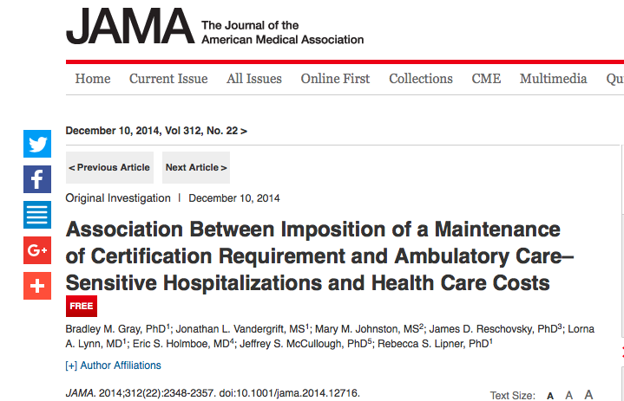
No Proof of Improved Patient Care Quality or Reduced Admissions

Slide 6
ABIM Webpage of Revenue Sources and Expenses

Slide 7
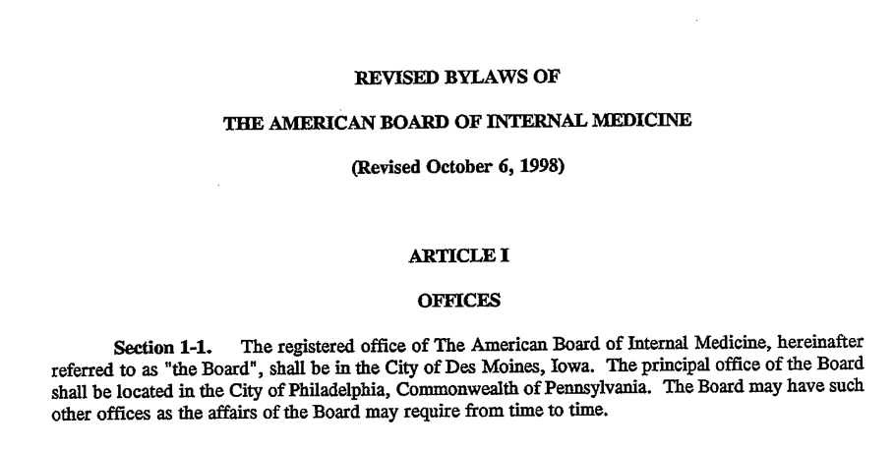
ABIM Bylaws Changed 1998 Okay for Board to Have Unlimited Conflicts

Slide 8
ABIM Foundation All about “Medical Professionalism?”
About Us Webpage from abimfoundation.org website captured 5/23/2015

Slide 9
Where and When was ABIM Foundation Created?
10/17/1989
PA

Slide 10
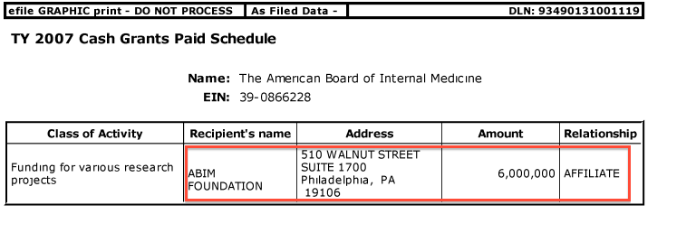
From IRS Form 990s: Why Are Our Testing Fees Going to ABIM Foundation?
Self-proclaimed “research”

Slide 11
More “Research” at the ABIM

Slide 12
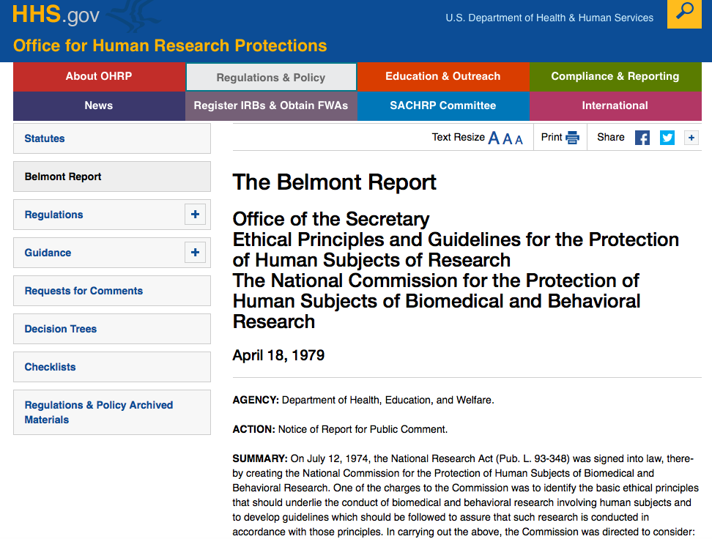
Respect for Persons
Beneficence
Justice

Slide 13
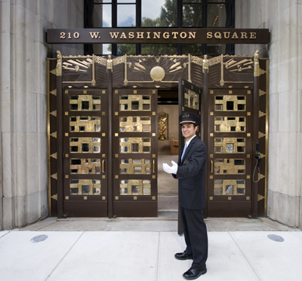
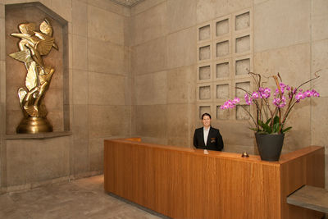
Investment Research?
Chauffeur-driven
BMW 7-series
Town Car
Concierge

Slide 14
- MOC and the ABIM Foundation- A Social Justice Experiment by ABIM/ABMS With Practicing Physicians As the Subjects
What Happens to Experienced Physicians Who Fail?
(Never Studied - No plans to do so)
What happens to patient care / patient access to care?
(Never Studied – No plans to do so)
Numerous Corporate / Government Conflicts of Interest
(Never scrutinized / no oversight)
How is Re-certification Data to be Sold / Protected / Utilized?
(Never disclosed / studied / scrutinized – no protections / due process)

Slide 15
COIs: National Quality Forum and the ABIM 1998-2014
ABIM
Foundation
Christine Cassel, MD
$8 M
$30.66M
ABIM
National Quality Forum
ICE
$3.3M
2004
Govt Grants
Other
Grants
Cert
MOC
Incentive
Payment
2012-4
Taxpayers
(Patients)
Doctors
CMS
ACP
$1.4M
2000
Richard Baron, MD
Key: ABIM (American Board of Internal Medicine); ACP (American College of Physicians), ICE (Institute of Clinical Evaluation), CMS (Center for Medicare and Medicaid Services), MOC (Maintenance of Certification)

Slide 16
What’s Been Going On?
ABIM Foundation
secretly created in 1989 in PA using $55M- $80M in diplomate fees
Numerous IRS Form 990 discrepancies (undisclosed grants / contributions, etc.)
ABIM FY 2015: ABIM is $50,642,980 million in debt balanced by a promise of $87,706,270 in “deferred revenue”
Exorbitant staff / leadership compensation and perks (condo, spousal travel, etc)
Undisclosed lobbying
Strongman / boss tactics of intimidation / fear – two-time felon as “Director of Investigations,” used Federal Marshals to raid board review course
Unlimted COI potential (one now under DOJ investigation) - Political and corporate cronyism
Creation of lucrative ABMS monopoly of nearly $400M annually

Slide 17
What’s Been Going On?
Anti-trust?
2013
Antitrust suit filed in NJ AAPS vs ABIM
Civil Case 3:13-cv-2609-PGS-LHG
Moved to US Federal District Court, Northern IL (pending)
Racketeering?

Slide 18
Internet caused Self-Destruction of the ABMS MOC® Product
The ABMS Maintenance of Certification® brand irrevocably damaged / corrupt
No longer voluntary, despite ABMS claims
Divisive for the profession
Unethical / costly / discriminatory / damaging
No proof it benefits patients or physicians

Slide 19
How Did It Get This Far?
Lack of Oversight
Lack of Accountability
Unelected Members of Specialty Boards
No term limits
Financial collusion
Practicing physician indifference

Slide 20
Who will investigate and stop MOC®?

Slide 21
”Not I,” said the ABIM
“We’re sorry.”
"We invited CFOs of IM organizations to review our 990s and audited financials and they have uniformly said they don't see any issues”
– Richard Baron, MD

Slide 22
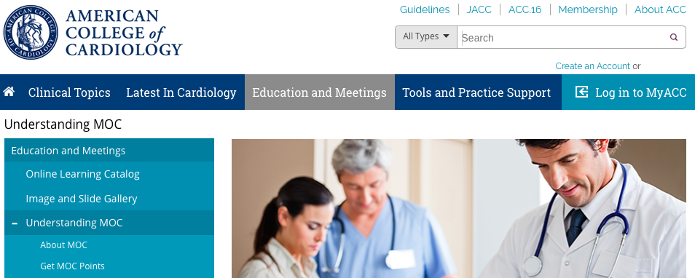
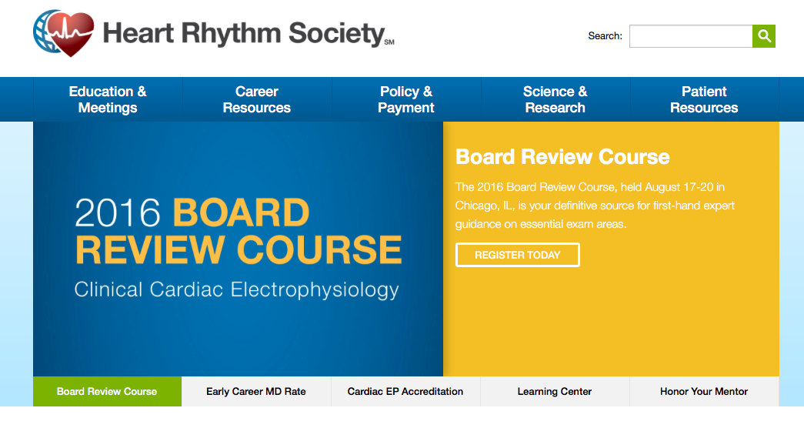
“Not I,” said Many of the Largest Medical Subspecialty Societies

Slide 23
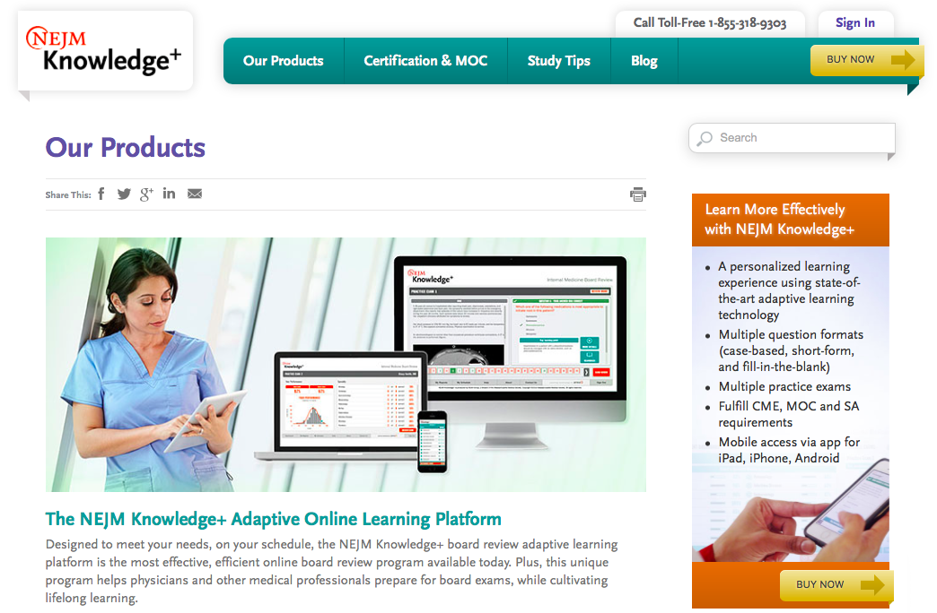
“Not I,” said the Major Medical Journal

Slide 24
“Not I,” said Main Stream Media

Slide 25
“I’ll do it myself”
Practicing physicians are discovering collective action

Slide 26
National Board of Physicians and Surgeons (NBPAS)

Slide 27
State Medical Societies
State Medical Associations recognize alternatives to ABMS MOC program and recertification process
Assemble facts and make credible formal legal request for investigation of ABIM/ABMS with appropriate oversight agency (IRS, FTC, DOJ, Iowa AG, SEC, OIG of HHS)
Enact laws to prohibit use of ABMS MOC requirement for hospital credentials, insurance panel participation, or licensure to practice medicine.

Slide 28
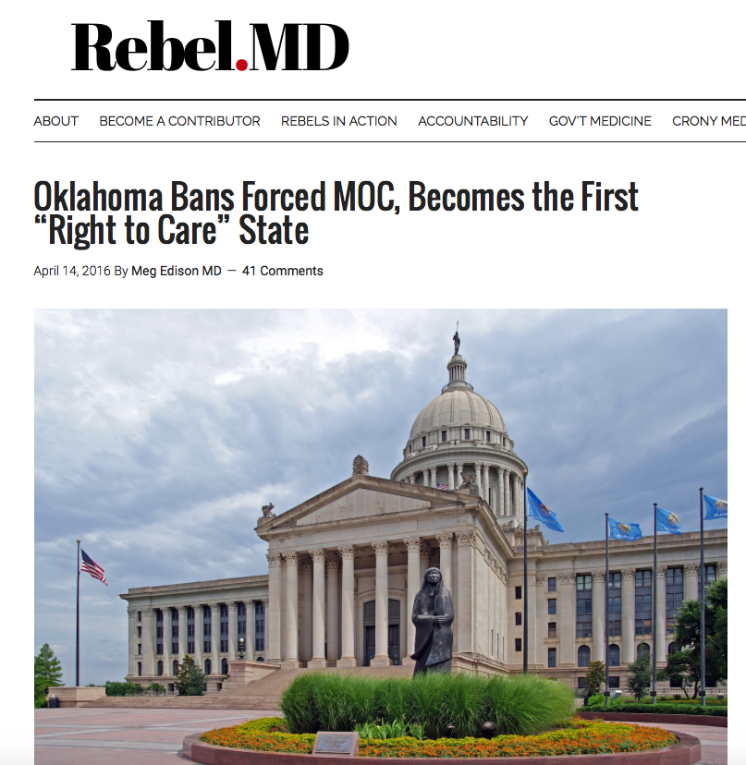
Oklahoma Unanimously Signs Anti-MOC legislation into law
“Nothing in the Oklahoma Allopathic Medical and Surgical Licensure and Supervision Act shall be construed as to require a physician to secure a Maintenance of Certification (MOC) as a condition of licensure, reimbursement, employment or admitting privileges at a hospital in this state. For the purposes of this subsection, “Maintenance of Certification (MOC)” shall mean a continuing education program measuring core competencies in the practice of medicine and surgery and approved by a nationally recognized accrediting organization.”

Slide 29
Kentucky – SB 17 Passed Unanimously 96-0

Slide 30
Michigan SB 5090 and 5091 (pending passage)
Expressly forbids hospitals from denying a physician admitting privileges on basis of MOC.
Insurers, too, prohibited from using MOC as condition of payment
State board could not make MOC condition of licensure

Slide 31
With many more to come…
What you can do:
Educate yourself
Stay up to date by reviewing http://changeboardrecert.com
Spread the word (educate others)
Stop paying for ABMS MOC
Follow suit/countersuit of ABIM vs Dr. Salas-Rushford at http://www.doctorsjustice.com
Follow AAPS vs ABPS Antitrust suit
Work locally with your Medical Staff Committee to prevent or remove MOC requirement from bylaws.
Work with state legislators to craft bill modeled after tougher Michigan anti-MOC language (Available at: http://www.legislature.mi.gov/documents/2015-2016/billintroduced/House/pdf/2015-HIB-5090.pdf)

