Slide 1
US Physician Credentialing and
ABMS Maintenance of Certification:
Medicine’s House of Cards
Westby G. Fisher, MD, FACC
Library of Congress, 2 Feb 2017

Slide 2
U.S. Medical Credentialing System Cumulative Assets - 2014
Accreditation Council for
Graduate Medical Education
(ACGME)
AHA
AAMC
NBME
CMSS
AMA
AOA
AACOM
ABMS
ABIM
ABFP
ABP
19 more…
$662M
$280M
$452M
$52M
$0.4M
$70M
$21M
The American Board of Internal Medicine (ABIM) is the largest member board of the American Board of Medical Specialties and is responsible for credentialing one quarter of all US physicians.
$1 Billion

Slide 3
My ABIM “Board Certification” Story
ABIM Created
1936
1986- Unilateral Decision to Implement Time-Limited Certification
1989 –WF Internal Medicine (#127308) “Grandfather”
1990 – All FUTURE Board Certification Becomes Time-limited
and must be MAINTAINED every 10 years (MOC is born)
1993 – WF Cardiovascular Disease
1994 – WF Clinical Cardiac Electrophysiology
2003 – WF Cardiovascular Disease
2004 –WF Clinical Cardiac Electrophysiology
2013 – WF Cardiovascular Disease
2014 –WF Clinical Cardiac Electrophysiology
Lifetime Cert
Age Discrimination
Philosophy: “Excellence” “Adequacy”
1990
Maintenance of Certification
Increasing Complexity and Cost
2017

Slide 4
Defining Physician “Quality”
ABIM/ABMS Definition
Believes medicine best learned on computer
Memorizes well
Willing to pay $23,000 every 10 years
Willing to be coerced to sign legal contract promising secrecy
Accepts old database questions as gospel
Doesn’t ask questions
Can pass a test
Patient Definition
Years of Experience
Good Communicator
Eye contact
Detailed history
Physical Exam
Knowledgeable
Constantly learning / applies new knowledge
Empathic
Surgical dexterity

Slide 5
Cost Analysis of MOC® Re-certification
$23,607 per internist every 10 years (95% CI, $5380 to $66,383)
2015: Cumulatively MOC costs $5.7 Billion/10 years
TIME: 32.7 million physician-hours spent on MOC
Sandhu AT, Dudley RA, Kazi DS. The Cost Analysis of American Board of Internal Medicine’s Maintenance of Certification Program. Ann intern Med 2015; 163(6): 401-408. doi:10.7326/M15-1011

Slide 6
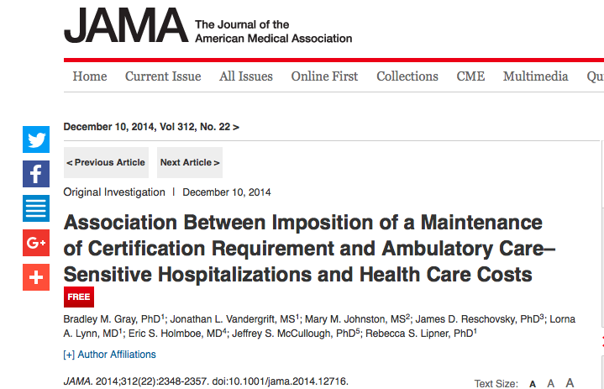
No Proof of Improved Patient Care Quality or Reduced Admissions

Slide 7
ABIM Webpage of Revenue Sources and Expenses

Slide 8
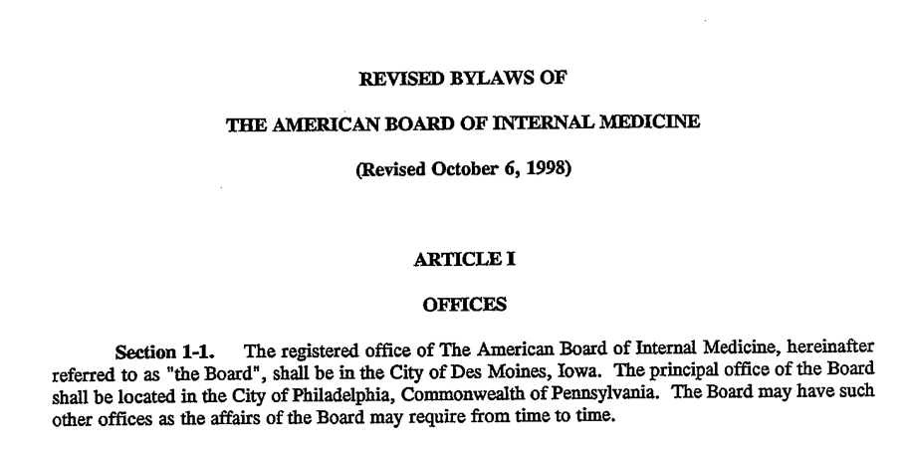
ABIM Bylaws Changed 1998 Okay for Board to Have Unlimited Conflicts

Slide 9
ABIM Foundation “Improving healthcare through advancement of medical professionalism?”
Established
1999?
About Us Webpage from abimfoundation.org website captured 5/23/2015

Slide 10
IRS Form 990 Where and When as ABIM Foundation Created?

Slide 11
Where and When was ABIM Foundation Created?
Created
10/17/1989
in PA

Slide 12
How much money did ABIM Foundation have the year it was “created” in 1999?
$59,618,428

Slide 13
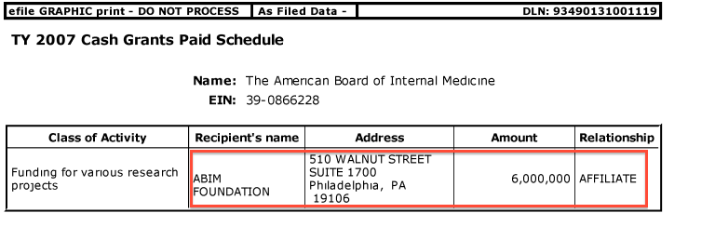
From IRS Form 990s:
Why Testing Fees Are Going to
ABIM Foundation
Self-proclaimed “research”

Slide 14
More “Research” at the ABIM

Slide 15
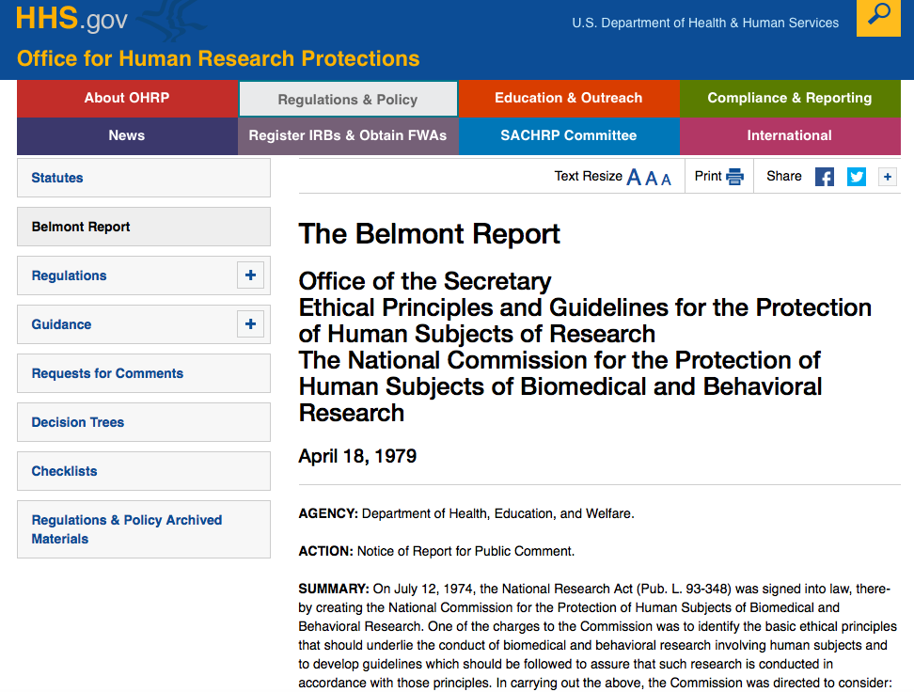
Respect for Persons
Beneficence
Justice

Slide 16
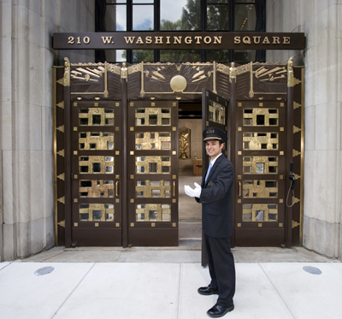
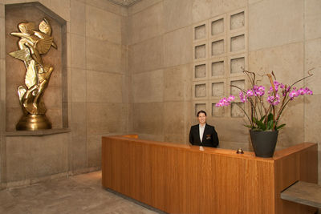
ABIM Foundation
Real Estate Investment Research in 2007?
Chauffeur-driven
BMW 7-series
Town Car
Concierge

Slide 17
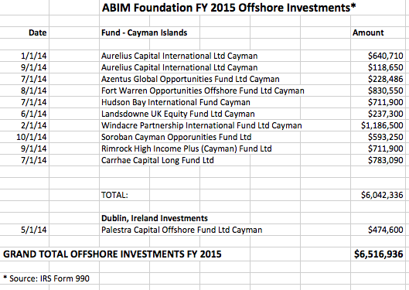
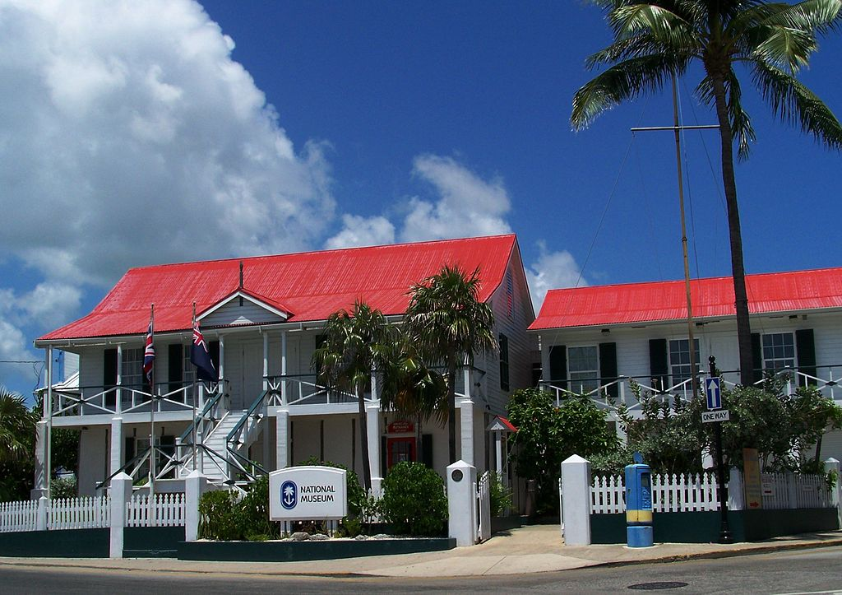
ABIM Foundation Retirement Fund Research?
In 2014, $6,516,936 were invested in Cayman Islands:

Slide 18
- MOC and the ABIM Foundation- A Social Justice Experiment by ABIM/ABMS With Practicing Physicians As the Subjects?
What Happens to Experienced Physicians Who Fail MOC Exam?
(Never Studied - No plans to do so)
What happens to patient care / patient access to care?
(Never Studied – No plans to do so)
Numerous Corporate / Government Conflicts of Interest
(Never scrutinized / no oversight)
How is Re-certification Data to be Sold / Protected / Utilized?
(Never disclosed / studied / scrutinized – no protections / due process)

Slide 19
COIs: National Quality Forum and the ABIM 1990-2017
NCQA
(Credentials Insurers )
Insurers Use MOC
ABIM
Foundation
Christine Cassel, MD
$230K
$1.6M
$8 M
Premier,Inc
Kaiser HospGroup
$30.66M
$400M
ABIM
CECity
National Quality Forum
ICE
$3.3M
2004
Govt Grants
Other
Grants
$5.5M
Cert
MOC
Incentive
Payment
2012-4
Taxpayers
(Patients)
Doctors
CMS
ACP
$1.4M
2000
Richard Baron, MD
Key: ABIM (American Board of Internal Medicine); NCQA (National Committee for Quality Assurance); ACP (American College of Physicians), ICE (Institute of Clinical Evaluation), CMS (Center for Medicare and Medicaid Services), MOC (Maintenance of Certification)

Slide 20
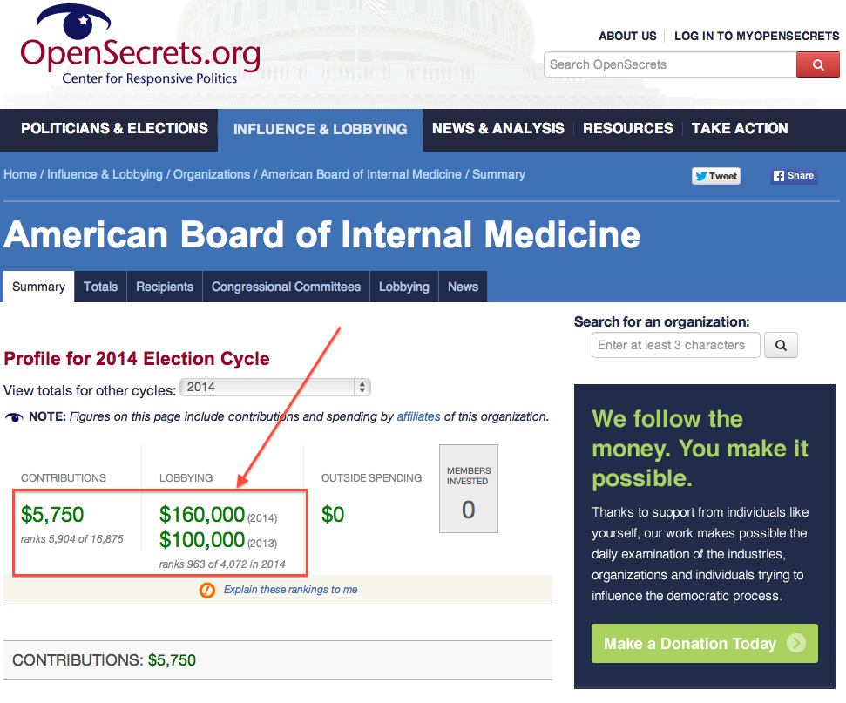
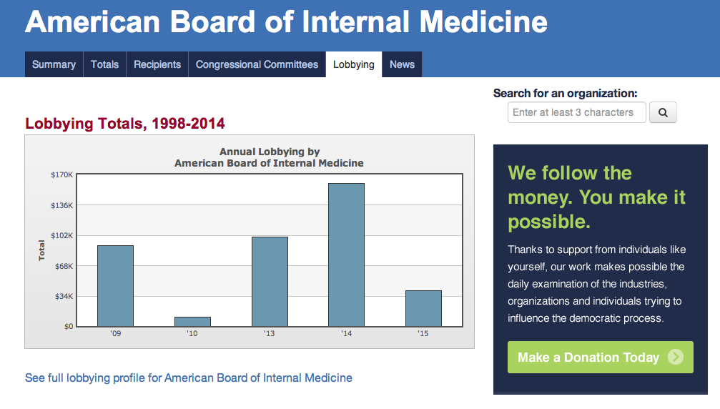
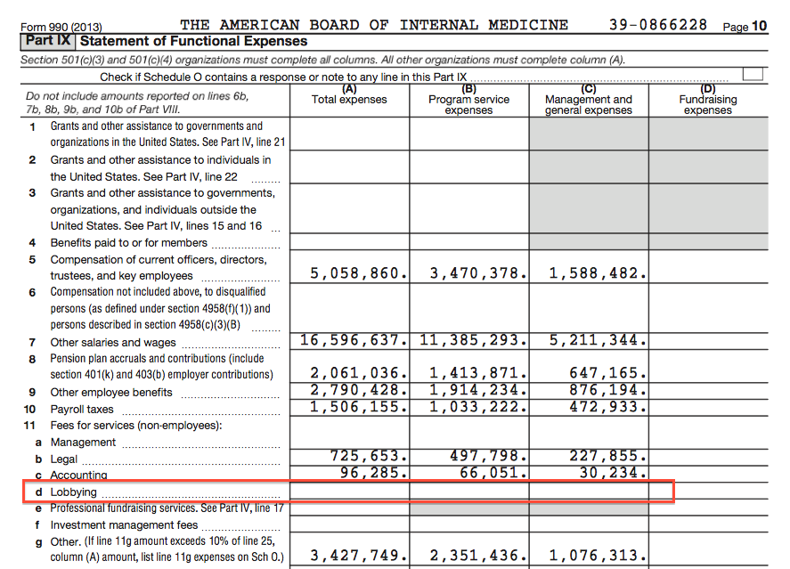
What’s Been Going On? Illegal Lobbying?

Slide 21
What’s Been Going On? ABIM Strongman Tactics
ABIM “Director of Investigations” Ariel Benjamin Mannes 2008 – 2017
Felony #006438: Received two convictions for (1) impersonating a police officer and (2) carrying unregistered firearm after assaulting night club patron in 2005. Lost appeal in 2008. Then hired by ABIM.
Coordinated ACGME-accredited Arora Board Review course “investigation” in 2009 **
Presented “evidence” to federal judge with Christine Cassel, MD and Rebecca Baranowski that resulted in issuance of sealed “writ to seize” of materials from Dr. Arora’s home.
Home raid on Dr. Arora’s residence conducted by Federal Marshals , Mr. Mannes, and ABIM’s attorneys Hara Jacobs and Marc Joseph Weinstein
Emails on Dr. Arora’s computers tracked and resulted in 134 sanctions and 5 suits filed by ABIM against residents in attendance at the course. Ms. Lynn Langdon (40-year non-physician employee of ABIM and COO) signs sanction letters.
Mannes served as Governor of Philadelphia Infragard with access to FBI, Postal Inspectors (FBI Infragard program prohibits felons from participating)
Consults to Am Board of Pediatrics and Am Board of Medical Specialties on Test Security, paid by ABIM. Owns business “Exam Integrity Services LLC” registered in FL in 2015
Kyterion and Caveon test security firm ties (Mr. Weinstein now on staff at Caveon)
* District of Columbia Court Cases Online, 2005 Felony Conviction #006438 at https://www.dccourts.gov/cco/maincase.jsf
** American Board of Internal Medicine vs Arora, et at. Case 2:09-cv-05707-JCJ at http://pacer.gov

Slide 22
What’s Been Going On?
Anti-trust? Racketeering?
2013
Antitrust suit filed in NJ AAPS vs ABIM
Civil Case 3:13-cv-2609-PGS-LHG
Moved to US Federal District Court, Northern IL (pending) but has not been touched in court docket since January 2015

Slide 23
It’s Not Just the ABIM
ABMS - profits selling physician credentialing info via for-profit ABMS Solutions, LLC in Georgia (listed in IL on tax forms)
ABFM – Owns ABFM Realty, LLC and profits from managing $4.2M office building they purchased with physician testing fees.
ABP – Owns a 2.8 acre pond; CEO retired with $2.4M in 2012, earned $793,438 in 2014 as consultant working 8 hrs/week
Several member boards own land only.

Slide 24
Internet caused Self-Destruction of the ABMS MOC® Product
The ABMS Maintenance of Certification® brand irrevocably damaged / corrupt
No longer voluntary, despite ABMS claims
Divisive for the profession
Unethical / costly / discriminatory / damaging
No proof it benefits patients or physicians

Slide 25
How Did It Get This Far?
Lack of Oversight
Lack of Accountability
Unelected Members of Specialty Boards
Unlimited conflicts of interest
No term limits
Financial collusion
Practicing physician indifference

Slide 26
Who will investigate and stop MOC®?

Slide 27
”Not I,” said the ABIM
“We’re sorry.”
"We invited CFOs of IM organizations to review our 990s and audited financials and they have uniformly said they don't see any issues”
– Richard Baron, MD

Slide 28
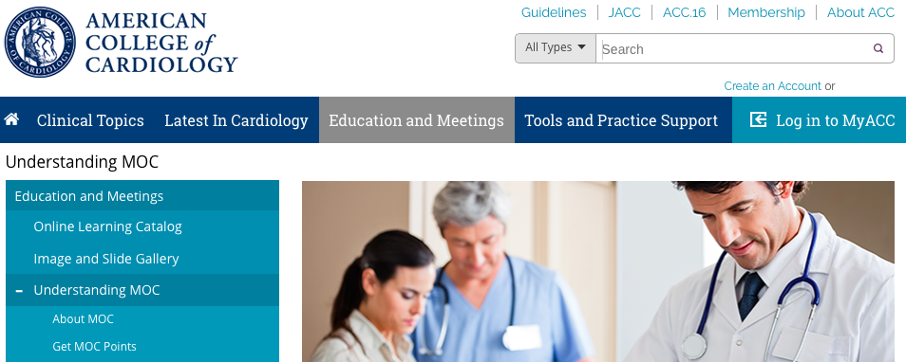
“Not I,” said Many of the Largest Medical Subspecialty Societies

Slide 29
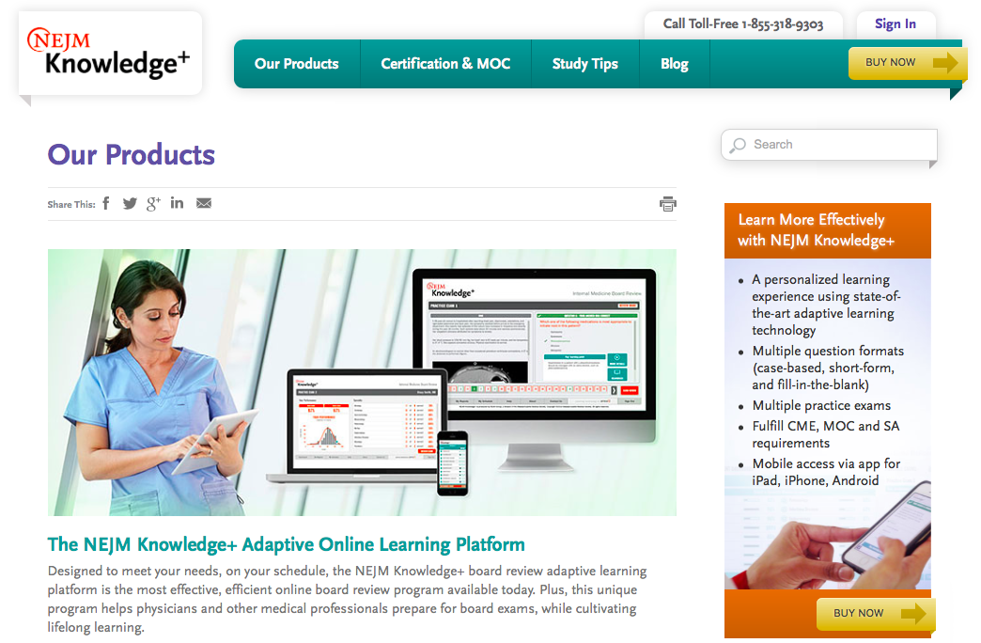
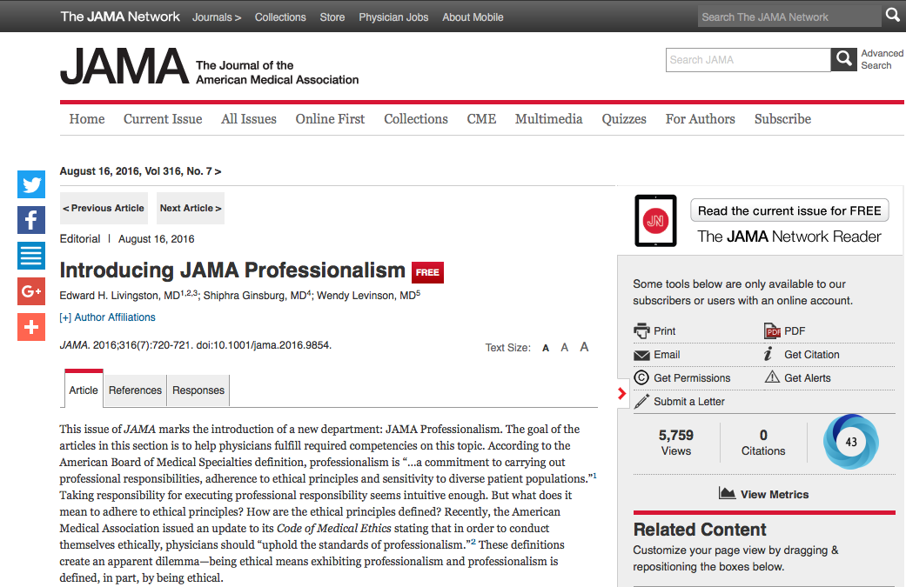
“Not I,” said the Major Medical Journals

Slide 30
“Not I,” said Main Stream Media

Slide 31
“I’ll do it myself”

Slide 33
State Medical Societies
State Medical Associations recognize alternatives to ABMS MOC program and recertification process
Assemble facts and make credible formal legal request for investigation of ABIM/ABMS with appropriate oversight agency (IRS, FTC, DOJ, Iowa AG, SEC, OIG of HHS)
Enact laws to prohibit use of ABMS MOC requirement for hospital credentials, insurance panel participation, or licensure to practice medicine.

Slide 34
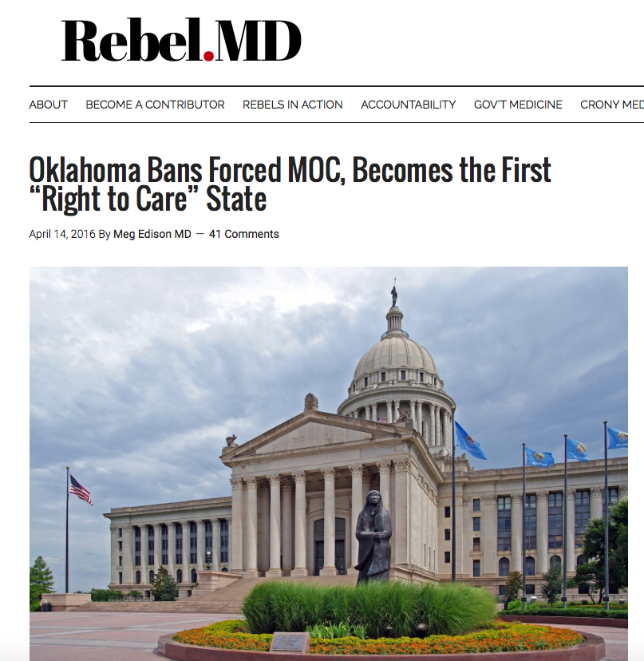
Oklahoma Unanimously Signs Anti-MOC legislation into law
“Nothing in the Oklahoma Allopathic Medical and Surgical Licensure and Supervision Act shall be construed as to require a physician to secure a Maintenance of Certification (MOC) as a condition of licensure, reimbursement, employment or admitting privileges at a hospital in this state. For the purposes of this subsection, “Maintenance of Certification (MOC)” shall mean a continuing education program measuring core competencies in the practice of medicine and surgery and approved by a nationally recognized accrediting organization.”

Slide 35
Kentucky – SB 17 Passed Unanimously 96-0

Slide 36
Michigan SB 5090 and 5091 (pending passage)
Expressly forbids hospitals from denying a physician admitting privileges on basis of MOC.
Insurers, too, prohibited from using MOC as condition of payment
State board could not make MOC condition of licensure

Slide 37
With many more to come…

